Slide 1
Mining Sequences

Slide 2
Examples of Sequence
Web sequence:
  ⟨ {Homepage} {Electronics} {Digital Cameras} {Canon Digital Camera} {Shopping Cart} {Order Confirmation} {Return to Shopping} ⟩
Purchase history of a given customer
⟨{Java in a Nutshell, Intro to Servlets} {EJB Patterns},…⟩
Sequence of classes taken by a computer science major:
⟨ {Algorithms and Data Structures, Introduction to Operating Systems} {Database Systems, Computer Architecture} {Computer Networks, Software Engineering} {Computer Graphics, Parallel Programming} …⟩

Slide 3
Formal Definition of a Sequence
A sequence is an ordered list of elements (transactions)
  s = < e₁ e₂ e₃ … >
  Each element contains a collection of events (items)
  e_{i} = {i₁, i₂, …, i_{k}}
  Each element is attributed to a specific time or location
A k-sequence is a sequence that contains k events (items)
Element (Transaction)
Event
(Item)
i₁
i₂
i₁
i₃
i₂
i₂
i₃
i₄
Sequence

Slide 4
Formal Definition of a Subsequence
A sequence ⟨ a₁ a₂ … a_{n} ⟩ is contained in another sequence ⟨ b₁ b₂ … b_{m} ⟩ (m ≥ n) if there exist integers
i₁ < i₂ < … < i_{n} such that a₁ ⊆ b_{i1} , a₂ ⊆ b_{i2}, …, a_{n} ⊆ b_{in}
Data sequence | Subsequence | Contained?
⟨ {2,4} {3,5,6} {8} ⟩ | ⟨ {2} {3,5} ⟩ | Yes
⟨ {1,2} {3,4} ⟩ | ⟨ {1} {2} ⟩ | No
⟨ {2,4} {2,4} {2,5} ⟩ | ⟨ {2} {4} ⟩ | Yes
Support of a subsequence w is the fraction of data sequences that contain w
A sequential pattern is a frequent subsequence (i.e., a subsequence whose support is ≥ minsup)

Slide 5
Sequential Pattern Mining: Definition
Given:
  a database of sequences
  a user-specified minimum support threshold, minsup
Task:
  Find all subsequences with support ≥ minsup
Challenge:
  Many more candidate sequential patterns than candidate itemsets.

Slide 6
Sequential Pattern Mining: Example
E.g.
A: <{1,2,4}, {2,3}, {5}>
B: …
Minsup = 50% i.e. min. sup. count = 2
Examples of Frequent
Subsequences:
< {1,2} > s=60%
< {2,3} > s=60%
< {2,4}> s=80%
< {3} {5}> s=80%
< {1} {2} > s=80%
< {2} {2} > s=60%
< {1} {2,3} > s=60%
< {2} {2,3} > s=60%
< {1,2} {2,3} > s=60%
Group
Timestamp
Events
A
1
1,2,4
A
2
2,3
A
3
5
B
1
1,2
B
2
2,3,4
C
1
1,2
C
2
2,3,4
C
3
2,4,5
D
1
2
D
2
3, 4
D
3
4, 5
E
1
1, 3
E
2
2, 4, 5

Slide 7
Extracting Sequential Patterns
Given n events: i₁, i₂, i₃, …, i_{n}
Candidate 1-subsequences:
    <{i₁}>, <{i₂}>, <{i₃}>, …, <{i_{n}}>
Candidate 2-subsequences:
    <{i₁, i₂}>, <{i₁, i₃}>, …, <{i₁} {i₁}>, <{i₁} {i₂}>, …, <{i_{n-1}} {i_{n}}>
Candidate 3-subsequences:
    <{i₁, i₂ , i₃}>, <{i₁, i₂ , i₄}>, …, <{i₁, i₂} {i₁}>, <{i₁, i₂} {i₂}>, …,
    <{i₁} {i₁ , i₂}>, <{i₁} {i₁ , i₃}>, …, <{i₁} {i₁} {i₁}>, <{i₁} {i₁} {i₂}>, …

Slide 8
APRIORI-like Algorithm
Make the first pass over the sequence database to yield all the 1-element frequent sequences
Repeat until no new frequent sequences are found
  Candidate Generation:
    Merge pairs of frequent subsequences found in the (k-1)^{th} pass to generate candidate sequences that contain k items
  Candidate Pruning:
    Prune candidate k-sequences that contain infrequent (k-1)-subsequences
  Support Counting:
    Make a new pass over the sequence database to find the support for these candidate sequences
    Eliminate candidate k-sequences whose actual support is less than minsup

Slide 9
Candidate Generation
Base case (k=2):
  Merging two frequent 1-sequences <{i₁}> and <{i₂}> will produce four candidate 2-sequences:
  <{i₁}, {i₂}>, <{i₂}, {i₁}>, <{i₁, i₂}>, <{i₂, i₁}>
General case (k>2):
  A frequent (k-1)-sequence w₁ is merged with another frequent
  (k-1)-sequence w₂ to produce a candidate k-sequence if the subsequence obtained by removing the first event in w₁ is the same as the subsequence obtained by removing the last event in w₂
  The resulting candidate after merging is given by the sequence w₁ extended with the last event of w₂.
      If the last two events in w₂ belong to the same element, then the last event in w₂ becomes part of the last element in w₁
      Otherwise, the last event in w₂ becomes a separate element appended to the end of w₁

Slide 10
Candidate Generation Examples
Merging the sequences
w₁=<{1} {2 3} {4}> and w₂ =<{2 3} {4 5}>
will produce the candidate sequence < {1} {2 3} {4 5}> because the last two events in w₂ (4 and 5) belong to the same element
Merging the sequences
w₁=<{1} {2 3} {4}> and w₂ =<{2 3} {4} {5}>
will produce the candidate sequence < {1} {2 3} {4} {5}> because the last two events in w₂ (4 and 5) do not belong to the same element
Finally, the sequences <{1}{2}{3}> and <{1}{2, 5}> don’t have to be merged (Why?)
Because removing the first event from the first sequence doesn’t give the same subsequence as removing the last event from the second sequence.
If <{1}{2,5}{3}> is a viable candidate, it will be generated by merging a different pair of sequences, <{1}{2,5}> and <{2,5}{3}>.

Slide 11
Example
Frequent
3-sequences
Candidate
< {1} {2} {3} >
< {1} {2 5} >
Generation
< {1} {5} {3} >
Candidate
< {2} {3} {4} >
< {1} {2} {3} {4} >
< {2 5} {3} >
< {1} {2 5} {3} >
Pruning
< {3} {4} {5} >
< {1} {5} {3 4} >
< {5} {3 4} >
< {2} {3} {4} {5} >
< {1} {2 5} {3} >
< {2 5} {3 4} >

Slide 12
Timing Constraints
Buyer A: < {TV} … {DVD Player} >
Buyer B: < {TV} … {DVD Player} >
…
The sequential pattern of interest is
<{TV}{DVD Player}>
which suggests that people who buy TV will also soon buy DVD player.
A person who bought a TV ten years earlier should not be considered as supporting the pattern because the time gap between the purchases is too long.

Slide 13
Timing Constraints
{A B} {C} {D E}
<= max-gap
<= max-span
max-gap = 2, max-span= 4
Data sequence | Subsequence | Contained?
<{2,4} {3,5,6} {4,7} {4,5} {8}> | < {6} {5} >
<{1} {2} {3} {4} {5}> | < {1} {4} >
<{1} {2,3} {3,4} {4,5}> | < {2} {3} {5} >
<{1,2} {3} {2,3} {3,4} {2,4} {4,5}> | < {1,2} {5} >

Slide 14
Timing Constraints
{A B} {C} {D E}
<= max-gap
<= max-span
max-gap = 2, max-span= 4
Data sequence | Subsequence | Contained?
<{2,4} {3,5,6} {4,7} {4,5} {8}> | < {6} {5} > | Yes
<{1} {2} {3} {4} {5}> | < {1} {4} >
<{1} {2,3} {3,4} {4,5}> | < {2} {3} {5} >
<{1,2} {3} {2,3} {3,4} {2,4} {4,5}> | < {1,2} {5} >

Slide 15
Timing Constraints
{A B} {C} {D E}
<= max-gap
<= max-span
max-gap = 2, max-span= 4
Data sequence | Subsequence | Contained?
<{2,4} {3,5,6} {4,7} {4,5} {8}> | < {6} {5} > | Yes
<{1} {2} {3} {4} {5}> | < {1} {4} > | No
<{1} {2,3} {3,4} {4,5}> | < {2} {3} {5} >
<{1,2} {3} {2,3} {3,4} {2,4} {4,5}> | < {1,2} {5} >

Slide 16
Timing Constraints
{A B} {C} {D E}
<= max-gap
<= max-span
max-gap = 2, max-span= 4
Data sequence | Subsequence | Contained?
<{2,4} {3,5,6} {4,7} {4,5} {8}> | < {6} {5} > | Yes
<{1} {2} {3} {4} {5}> | < {1} {4} > | No
<{1} {2,3} {3,4} {4,5}> | < {2} {3} {5} > | Yes
<{1,2} {3} {2,3} {3,4} {2,4} {4,5}> | < {1,2} {5} >

Slide 17
Timing Constraints
{A B} {C} {D E}
<= max-gap
<= max-span
max-gap = 2, max-span= 4
Data sequence | Subsequence | Contained?
<{2,4} {3,5,6} {4,7} {4,5} {8}> | < {6} {5} > | Yes
<{1} {2} {3} {4} {5}> | < {1} {4} > | No
<{1} {2,3} {3,4} {4,5}> | < {2} {3} {5} > | Yes
<{1,2} {3} {2,3} {3,4} {2,4} {4,5}> | < {1,2} {5} > | No

Slide 18
Mining Sequential Patterns with Timing Constraints
Approach 1:
  Mine sequential patterns without timing constraints
  Postprocess the discovered patterns
Approach 2:
  Modify algorithm to directly prune candidates that violate timing constraints
  Question:
    Does APRIORI principle still hold?

Slide 19
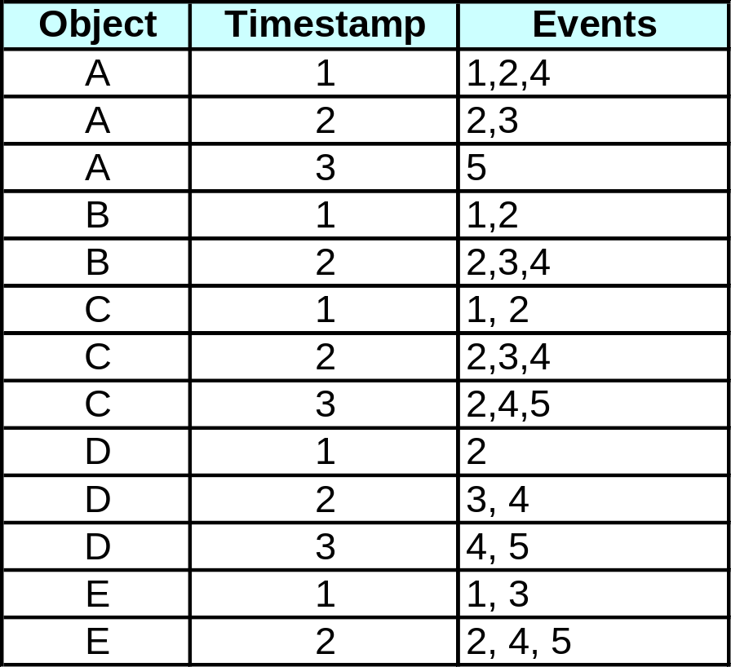
APRIORI Principle for Sequence Data
Suppose:
max-gap = 1
max-span = 5
<{2} {5}>
support = 40%
but
<{2} {3} {5}>
support = 60%
Problem exists because of max-gap constraint
This problem can avoided by using the concept of a contiguous subsequence.

Slide 20
Contiguous Subsequences
s is a contiguous subsequence of
w = <e₁, e₂ ,…, e_{k}>
if any of the following conditions holds:
  s is obtained from w by deleting an item from either e₁ or e_{k}
  s is obtained from w by deleting an item from any element e_{i} that contains at least 2 items
  s is a contiguous subsequence of s’ and s’ is a contiguous subsequence of w (recursive definition)
Examples: s = < {1} {2} >
  is a contiguous subsequence of
  < {1} {2 3}>, < {1 2} {2} {3}>, and < {3 4} {1 2} {2 3} {4} >
  is not a contiguous subsequence of
  < {1} {3} {2}> and < {2} {1} {3} {2}>

Slide 21
Modified Candidate Pruning Step
Modified APRIORI Principle
  If a k-sequence is frequent, then all of its contiguous (k-1)-subsequences must also be frequent
Candidate generation doesn’t change. Only pruning changes.
Without maxgap constraint:
  A candidate k-sequence is pruned if at least one of its (k-1)-subsequences is infrequent
With maxgap constraint:
  A candidate k-sequence is pruned if at least one of its contiguous (k-1)-subsequences is infrequent

